Slide 1
School of Geography and Geology McMaster University
WELCOME TO
GEO 4GA3
Applied Spatial Statistics

Slide 2
This session
Course Outline
Exercise: Student/instructor objectives

Slide 3
Instructor
Antonio Páez
Education:
Civil Engineering (ITESM, Mexico; Dec. 93)
M.Sc. Information (Tohoku, Japan; Sept. 97)
Ph.D. Engineering (Tohoku, Japan; Sept. 00)
Work:
CNEAS (Tohoku, Japan)
School of Geography and Geology (Jul. 02)

Slide 4
Instructor
Antonio Páez
Teaching
Research
Transportation, travel behavior, health geography
Spatial analysis

Slide 5
Where can you find me?
Antonio Páez
Contact information:
General Science Building 236
E-mail: paezha@mcmaster.ca
Telephone: 905-525-9140 ext. 26099
Office hours

Slide 6
Applied Spatial Statistics
Geographical Information Systems
Follow up to 3MB3: Statistical Analysis
Emphasis on spatial data and spatial effects

Slide 7
Course Description
Intermediate methods of spatial analysis
Course contents

Slide 8
Object-Attribute Model
Elemental spatial objects
Attribute scale

Slide 9
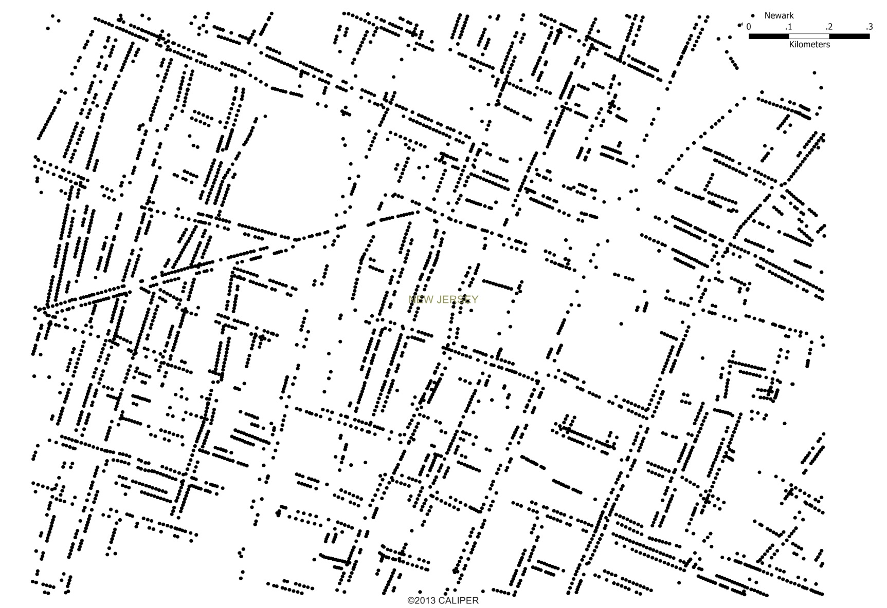
Points (L⁰)

Slide 10
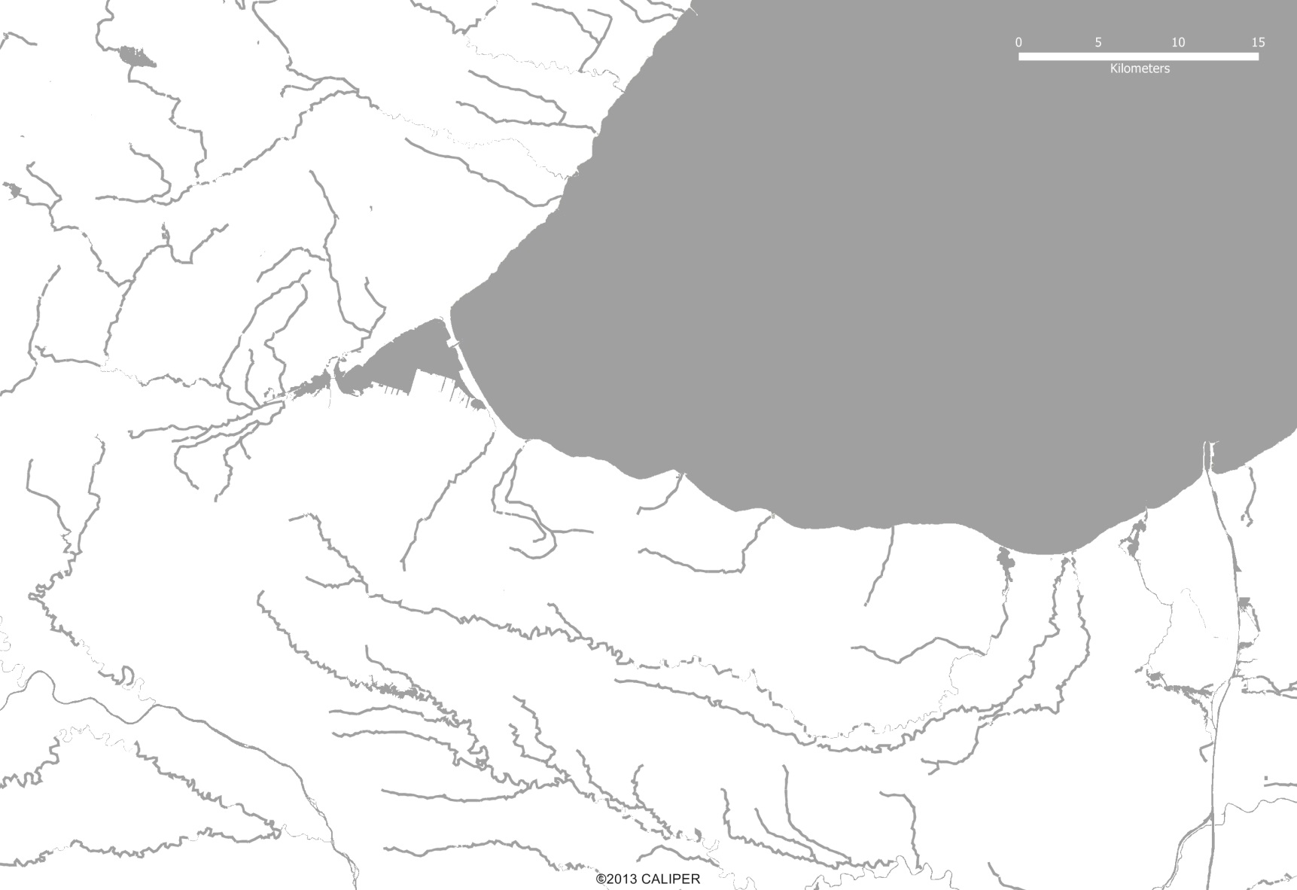
Lines (L¹)

Slide 11
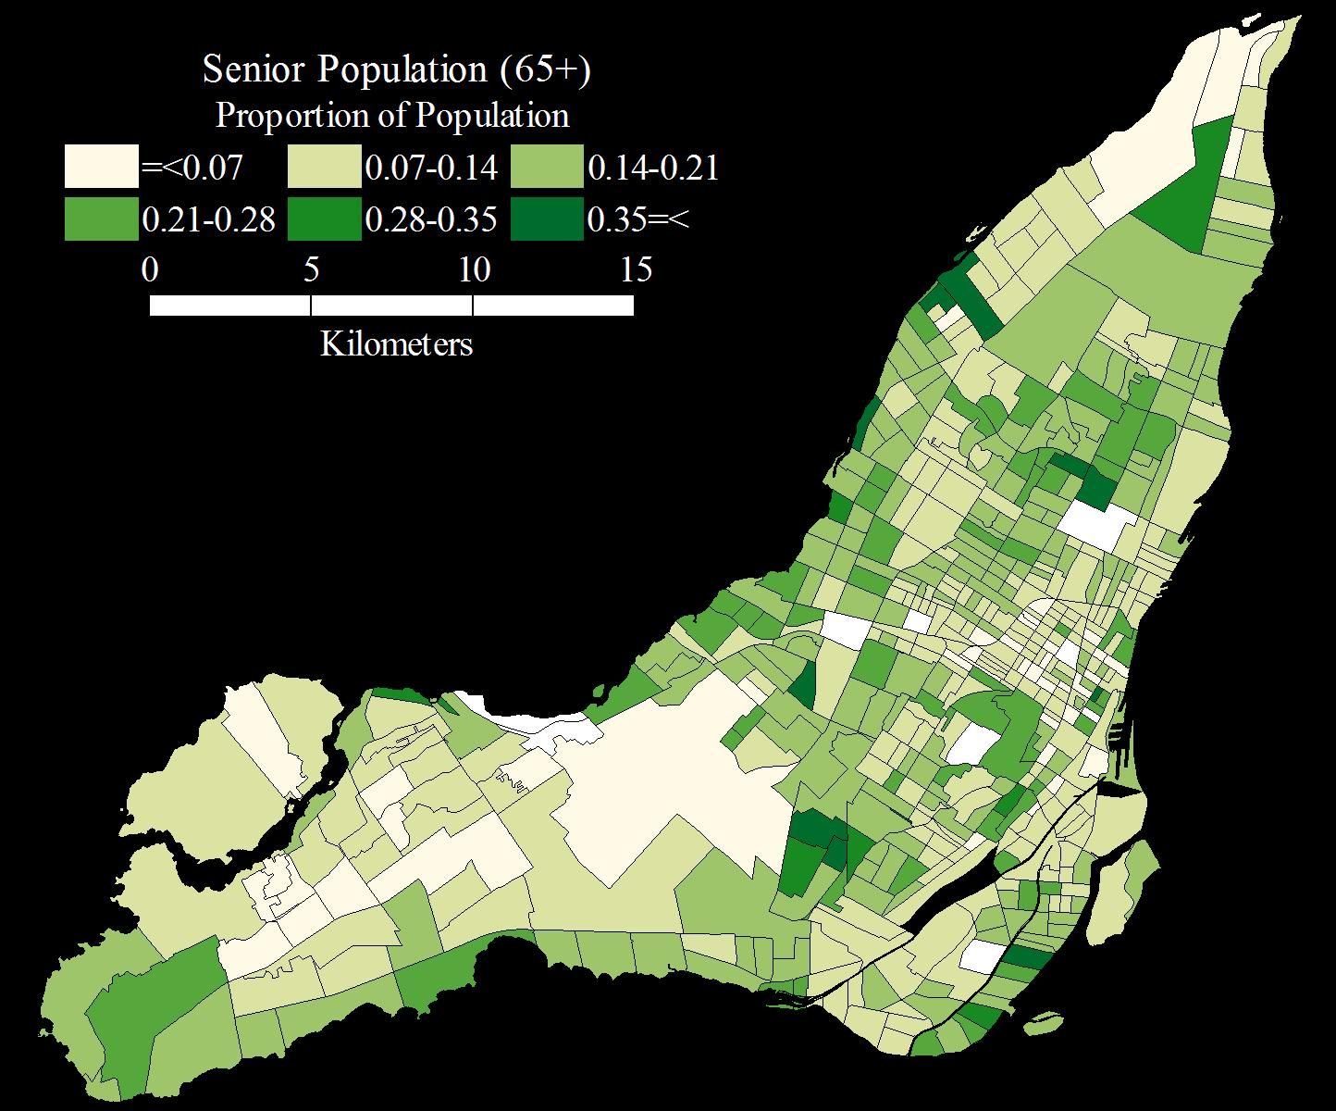
Area Objects (L²)
Notes:
African independence (obs = left, random = right)

Slide 12
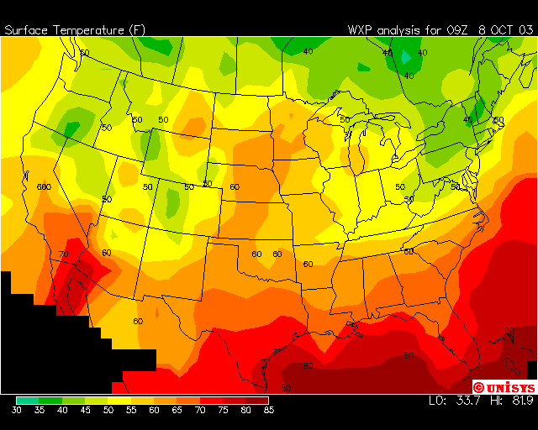
Fields (L³)

Slide 13
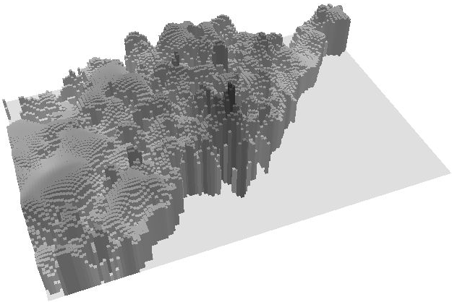
Fields (L³)

Slide 14
Attribute Scale

Slide 15
Potential of Spatial Data
Notes:
Book uses example of ozone level. While ozone concentration will differ from location to location, ozone levels at neighboring locations are likely to be related somehow. Similarly, house prices will vary over space, but neighboring ones are related.

Slide 16
Potential of Spatial Data
Formally test hypotheses through statistical methods
Estimate extent and form of relationships
Usually proceeds by identifying any heterogeneities in mean value and then modeling residuals or deviations from this trend.

Slide 17
Course Outline
Course objectives

Slide 18
Course Outline
Evaluation

Slide 19
Course Guidelines and Regulations
Contacting the instructor
Office hours
E-mail to set an appointment

Slide 20
Course Guidelines and Regulations
Course preparation
3 hours of prep/study time for each hour of lecture
More preparation = higher grades
Problems with the course? See me or a TA. Early identification of problems may help to solve them

Slide 21
Course Guidelines and Regulations
Handing in the projects
As per outline
Drop box in General Science Building
Late submissions

Slide 22
Course Guidelines and Regulations
Mark appeals:
Appeal directly to the person who marked your work
Appeals in writing: 24 hours rule (Within 15 days of receiving the work back)
Re-marking may result in a higher or lower grade!

Slide 23
Course Guidelines and Regulations
Students with special needs

Slide 24
Course Guidelines and Regulations
Missed work

Slide 25
Lectures and other events
Tentative schedule (see outline)

Slide 26
Lectures and other events
Lectures organized in Sessions
Each session is about 50 minutes long
Approximately 22 sessions in the course
Structure of a lecture

Slide 27
Exercise
Briefly explain (10-15 lines):
Your reasons for taking GEO 4GA3
Your objectives in this course
Submit using A2L

